Slide 1
Shading
Matt Evett
Department of Computer Science, Eastern Michigan University

Slide 2
Objectives
Learn to shade objects so their images appear three-dimensional
Introduce the types of light-material interactions
Build a simple reflection model---the Phong model--- that can be used with real time graphics hardware
Shading © Matt Evett 2004, Addison-Wesley 2002

Slide 3
Why we need shading
Suppose we build a model of a sphere using many polygons and color it with glColor. We get something like
But we want
Shading © Matt Evett 2004, Addison-Wesley 2002

Slide 4
Shading
Why does the image of a real sphere look like
Light-material interactions cause each point to have a different color or shade.
See lightposition.exe
Need to consider
  Light sources
  Material properties
  Location of viewer
  Surface orientation
Shading © Matt Evett 2004, Addison-Wesley 2002

Slide 5
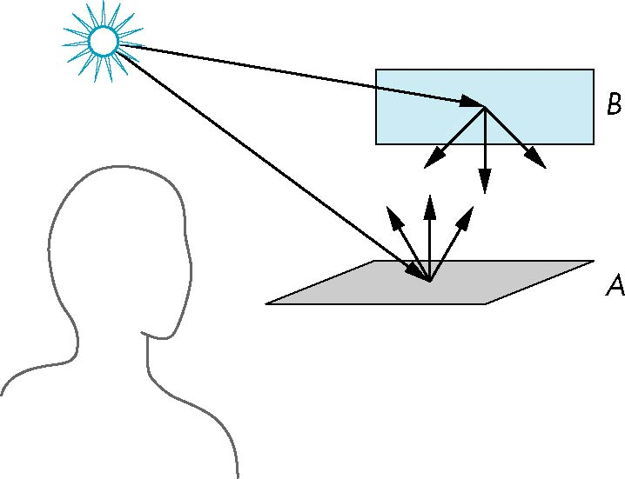
Scattering
Light strikes A
  Some scattered
  Some absorbed
Some of scattered light strikes B
  Some scattered
  Some absorbed
Some of this scatterd
light strikes A
and so on
Shading © Matt Evett 2004, Addison-Wesley 2002

Slide 6
Rendering Equation
The infinite scattering and absorption of light can be described by the rendering equation
  Cannot be solved in general
  Ray tracing is a special case for perfectly reflecting surfaces
Rendering equation is global and includes
  Shadows
  Multiple scattering from object to object
Shading © Matt Evett 2004, Addison-Wesley 2002

Slide 7
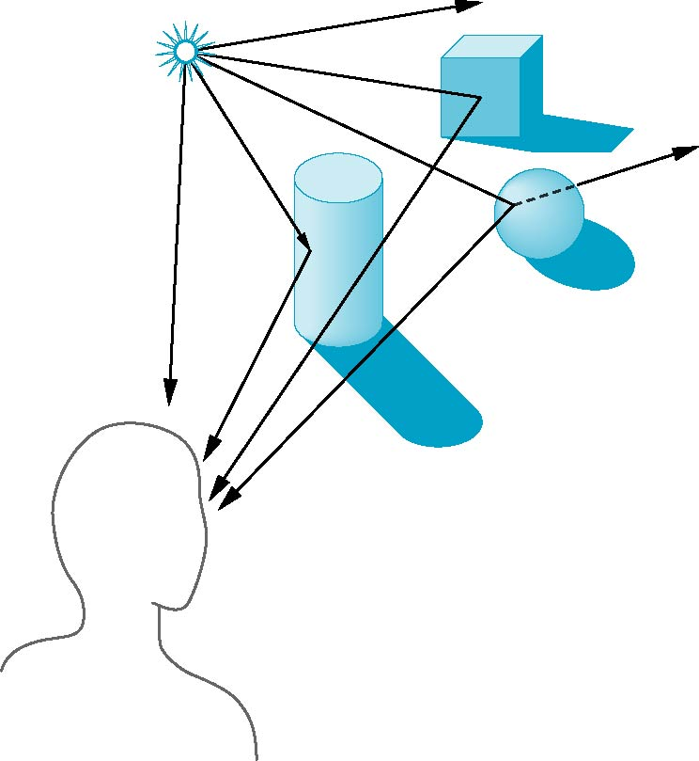
Global Effects
shadow
multiple reflection
translucent surface
Shading © Matt Evett 2004, Addison-Wesley 2002

Slide 8
Local vs Global Rendering
Correct shading requires a global calculation involving all objects and light sources
  Incompatible with pipeline model which shades each polygon independently (local rendering)
However, in computer graphics, especially real time graphics, we are happy if things “look right”
  Exist many techniques for approximating global effects
Shading © Matt Evett 2004, Addison-Wesley 2002

Slide 9
Light-Material Interaction
Light that strikes an object is partially absorbed and partially scattered (reflected)
The amount reflected determines the color and brightness of the object
  A surface appears red under white light because the red component of the light is reflected and the rest is absorbed
The reflected light is scattered in a manner that depends on the smoothness and orientation of the surface
Shading © Matt Evett 2004, Addison-Wesley 2002

Slide 10
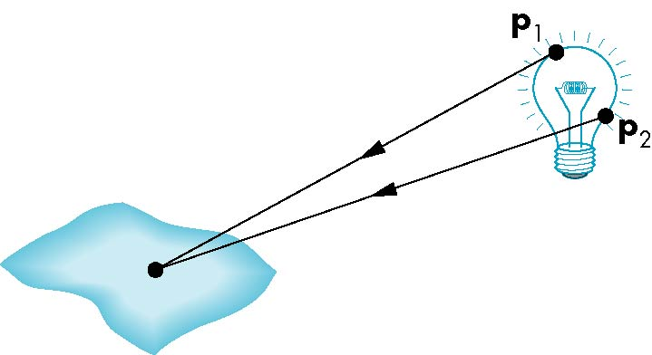
Light Sources
General light sources are difficult to work with because we must integrate light coming from all points on the source
Shading © Matt Evett 2004, Addison-Wesley 2002

Slide 11
Simple Light Sources
Point source
  Model with position and color
  Distant source = infinite distance away (parallel)
Spotlight
  Restrict light from ideal point source
Ambient light
  Same amount of light everywhere in scene
  Can model contribution of many sources and reflecting surfaces
Shading © Matt Evett 2004, Addison-Wesley 2002

Slide 12
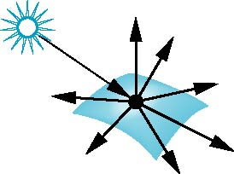
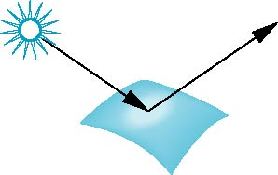
Surface Types
The smoother a surface, the more reflected light is concentrated in the direction a perfect mirror would reflect the light
A very rough surface scatters light in all directions
smooth surface
rough surface
Shading © Matt Evett 2004, Addison-Wesley 2002

Slide 13
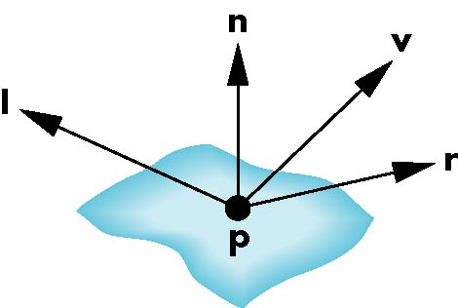
Phong Model
A simple model that can be computed rapidly
Has three components
  Diffuse
  Specular
  Ambient
Uses four vectors
  To source
  To viewer
  Normal
  Perfect reflector
Shading © Matt Evett 2004, Addison-Wesley 2002

Slide 14
Ambient Light
Ambient light is the result of multiple interactions between (large) light sources and the objects in the environment
Amount and color depend on both the color of the light(s) and the material properties of the object
Add k_{a} I_{a} to diffuse and specular terms
reflection coef
intensity of ambient light
Shading © Matt Evett 2004, Addison-Wesley 2002

Slide 15
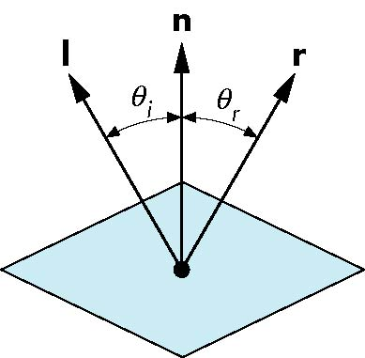
Ideal Reflector
Normal is determined by local orientation
Angle of incidence = angle of reflection
The three vectors must be coplanar
r = 2 (l · n ) n - l
Shading © Matt Evett 2004, Addison-Wesley 2002

Slide 16
Lambertian Surface
Perfectly diffuse reflector
Light scattered equally in all directions
Amount of light reflected is proportional to the vertical component of incoming light
  reflected light ~cos θ_{i}
  cos θ_{i} = l · n if vectors normalized
  There are also three coefficients, k_{r}, k_{b}, k_{g} that show how much of each color component is reflected
Shading © Matt Evett 2004, Addison-Wesley 2002

Slide 17

Specular Surfaces
Most surfaces are neither ideal diffusers nor perfectly specular (ideal refectors)
Smooth surfaces show specular highlights due to incoming light being reflected in directions concentrated close to the direction of a perfect reflection
specular
highlight
Shading © Matt Evett 2004, Addison-Wesley 2002

Slide 18
Modeling Specular Relections
Phong proposed using a term that dropped off as the angle between the viewer and the ideal reflection increased
I_{r} ~ k_{s} I cos^{α}φ
φ
reflected
intensity
shininess coef
incoming intensity
absorption coef
Shading © Matt Evett 2004, Addison-Wesley 2002

Slide 19
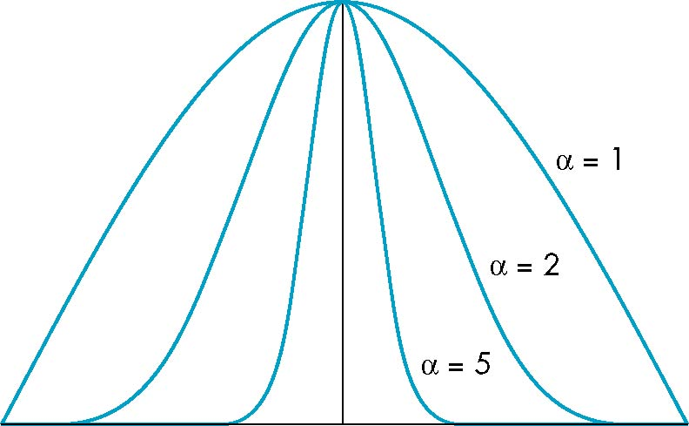
The Shininess Coefficient
Values of α between 100 and 200 correspond to metals
Values between 5 and 10 give surface that look plastic
cos^{α} φ
-90
φ
90
Shading © Matt Evett 2004, Addison-Wesley 2002

Slide 20
Ambient Light
Ambient light is the result of multiple interactions between (large) light sources and the objects in the environment
Amount and color depend on both the color of the light(s) and the material properties of the object
Add k_{a} I_{a} to diffuse and specular terms
reflection coef
intensity of ambient light
Angel: Interactive Computer Graphics 5E © Addison-Wesley 2009

Slide 21
Distance Terms
The light from a point source that reaches a surface is inversely proportional to the square of the distance between them
We can add a factor of the
form 1/(ad + bd +cd²) to
the diffuse and specular
terms
The constant and linear terms soften the effect of the point source
Shading © Matt Evett 2004, Addison-Wesley 2002

Slide 22
Light Sources
In the Phong Model, we add the results from each light source
Each light source has separate diffuse, specular, and ambient terms to allow for maximum flexibility even though this form does not have a physical justification
Separate red, green and blue components
Hence, 9 coefficients for each point source
  I_{dr}, I_{dg}, I_{db}, I_{sr}, I_{sg}, I_{sb}, I_{ar}, I_{ag}, I_{ab}
Shading © Matt Evett 2004, Addison-Wesley 2002

Slide 23
Material Properties
Material properties match light source properties
  Nine absorbtion coefficients
    k_{dr}, k_{dg}, k_{db}, k_{sr}, k_{sg}, k_{sb}, k_{ar}, k_{ag}, k_{ab}
  Shininess coefficient α
Shading © Matt Evett 2004, Addison-Wesley 2002

Slide 24
Adding up the Components
For each light source and each color component, the Phong model can be written (without the distance terms) as
I =k_{d} I_{d} l · n + k_{s} I_{s} (v · r )^{α} + k_{a} I_{a}
For each color component
we add contributions from
all sources
Shading © Matt Evett 2004, Addison-Wesley 2002

Slide 25
Modified Phong Model
The specular term in the Phong model is problematic because it requires the calculation of a new reflection vector and view vector for each vertex
Blinn suggested an approximation using the halfway vector that is more efficient
Angel: Interactive Computer Graphics 5E © Addison-Wesley 2009

Slide 26
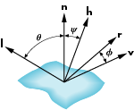
The Halfway Vector
h is normalized vector halfway between l and v
h = ( l + v )/ | l + v |
Angel: Interactive Computer Graphics 5E © Addison-Wesley 2009

Slide 27
Using the halfway vector
Replace (v · r )^{α} by (n · h )^{β}
β is chosen to match shineness
Note that halway angle is half of angle between r and v if vectors are coplanar
Resulting model is known as the modified Phong or Blinn lighting model
  Specified in OpenGL standard
Angel: Interactive Computer Graphics 5E © Addison-Wesley 2009

Slide 28
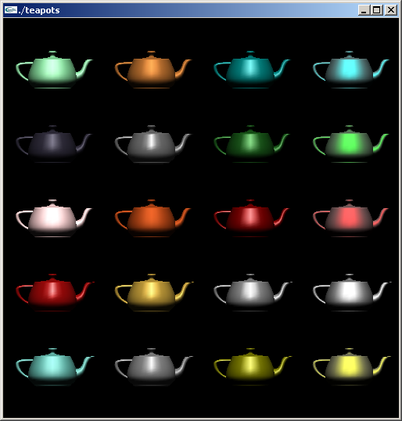
Example
Only differences in
these teapots are
the parameters
in the Phong model
Shading © Matt Evett 2004, Addison-Wesley 2002

Slide 29
Computation of Vectors
l and v are specified by the application
Can compute r from l and n
Problem is determining n
For simple surfaces it can be determined but how we determine n differs depending on underlying representation of surface
OpenGL leaves determination of normal to application
  Exception for GLU quadrics and Bezier surfaces (Chapter 11)
Angel: Interactive Computer Graphics 5E © Addison-Wesley 2009

Slide 30
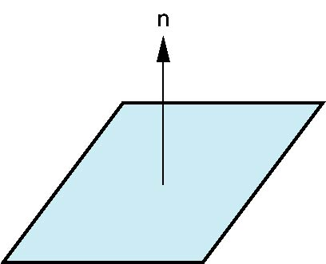
Plane Normals
Equation of plane: ax+by+cz+d = 0
From Chapter 4 we know that plane is determined by three points p₀, p₂, p₃ or normal n and p₀
Normal can be obtained by
n = (p₂-p₀) × (p₁-p₀)
Angel: Interactive Computer Graphics 5E © Addison-Wesley 2009

Slide 31

Normal to Sphere
Implicit function f(x,y,z)=0
Normal given by gradient
Sphere f(p)=p·p-1
n = [∂f/∂x, ∂f/∂y, ∂f/∂z]^{T}=p
Angel: Interactive Computer Graphics 5E © Addison-Wesley 2009

Slide 32
Parametric Form
For sphere
Tangent plane determined by vectors
Normal given by cross product
x=x(u,v)=cos u sin v
y=y(u,v)=cos u cos v
z= z(u,v)=sin u
∂p/∂u = [∂x/∂u, ∂y/∂u, ∂z/∂u]T
∂p/∂v = [∂x/∂v, ∂y/∂v, ∂z/∂v]T
n = ∂p/∂u × ∂p/∂v
Angel: Interactive Computer Graphics 5E © Addison-Wesley 2009

Slide 33
General Case
We can compute parametric normals for other simple cases
  Quadrics
  Parameteric polynomial surfaces
    Bezier surface patches (Chapter 11)
Angel: Interactive Computer Graphics 5E © Addison-Wesley 2009

